Slide 1
Steam Heat Controller
for Coover Hall
May11-19
Group Members:
Ben Jusufovic
Ben Cao
Thinh Luong
Curtis Mayberry
Advisers:
Jason Boyd
Lee Harker

Slide 2
Overview
Overview
Requirements
Design
Implementation
Testing
Conclusion
Questions

Slide 3
Project Overview
Problem Background and Statement
The old section of Coover hall utilizes steam valves to heat adjacent rooms. A steam valve in one room can control the temperature of up to five rooms. This leads to temperature offset in the rooms and continuous adjustment of the valve in order to accommodate the individuals within each room.

Slide 4
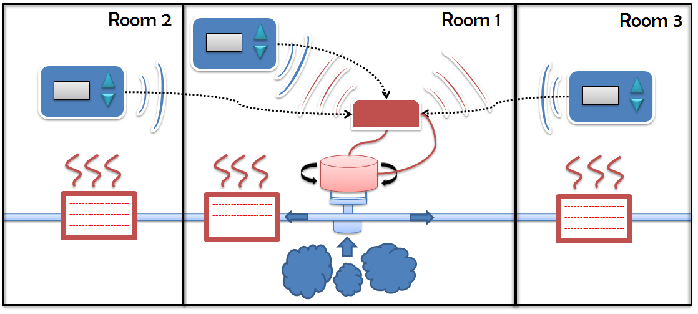
Project Requirements
Effective temperature control
Removable mechanical Interface
Wireless user interface
Web interface
Large graphic LCD
Casing size
Casing color
Project budget

Slide 5
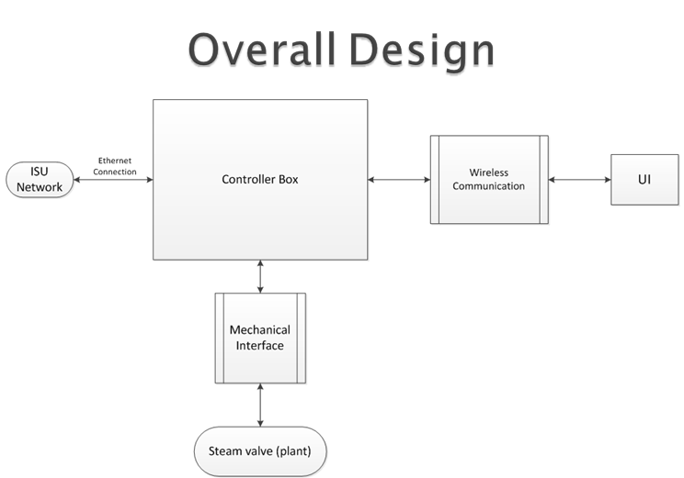
Project Design

Slide 6
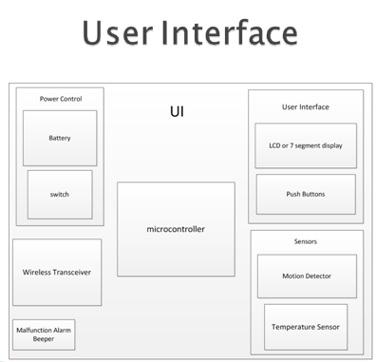
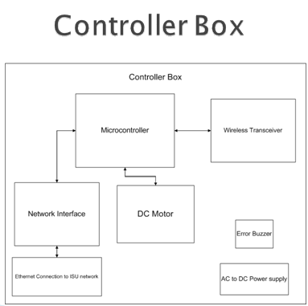
Project Design

Slide 7
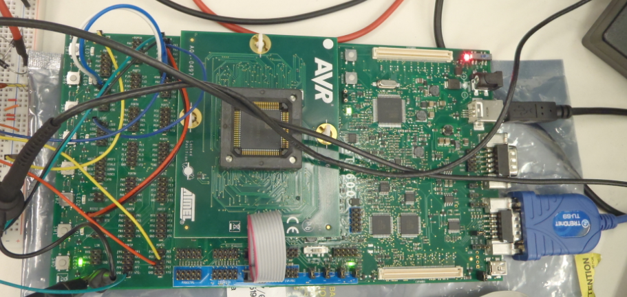
Project Implementation
AVR STK600 Development Kit

Slide 8
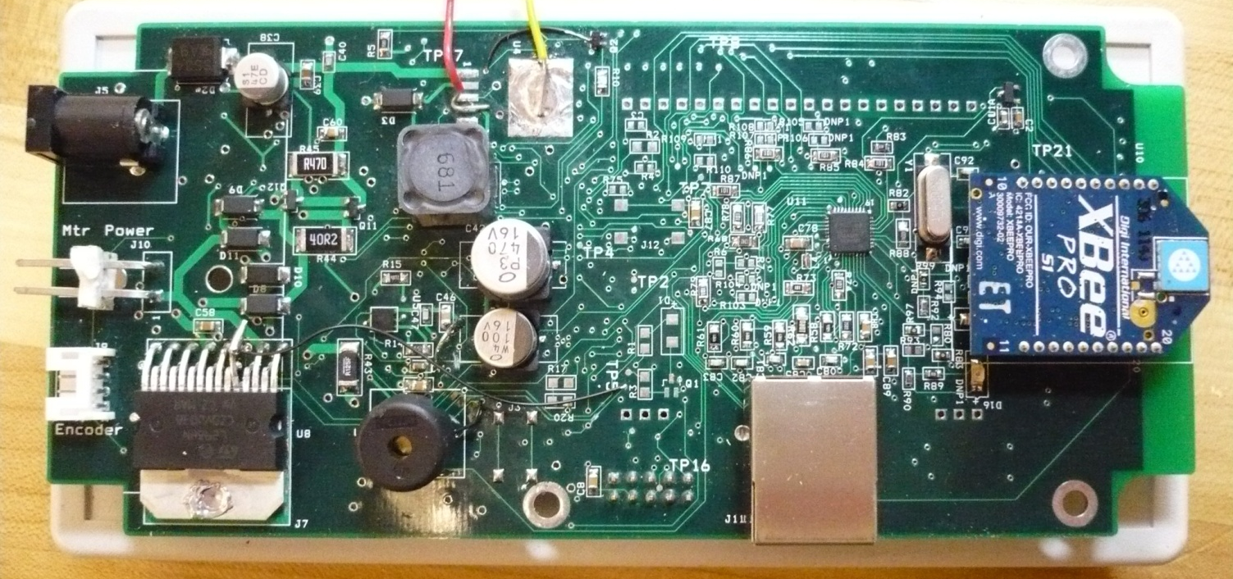
Project Implementation
Controller Box
Microcontroller
Wireless Transceiver
Ethernet Module
Buzzer
Power Supply
Motor Driver Circuit

Slide 9
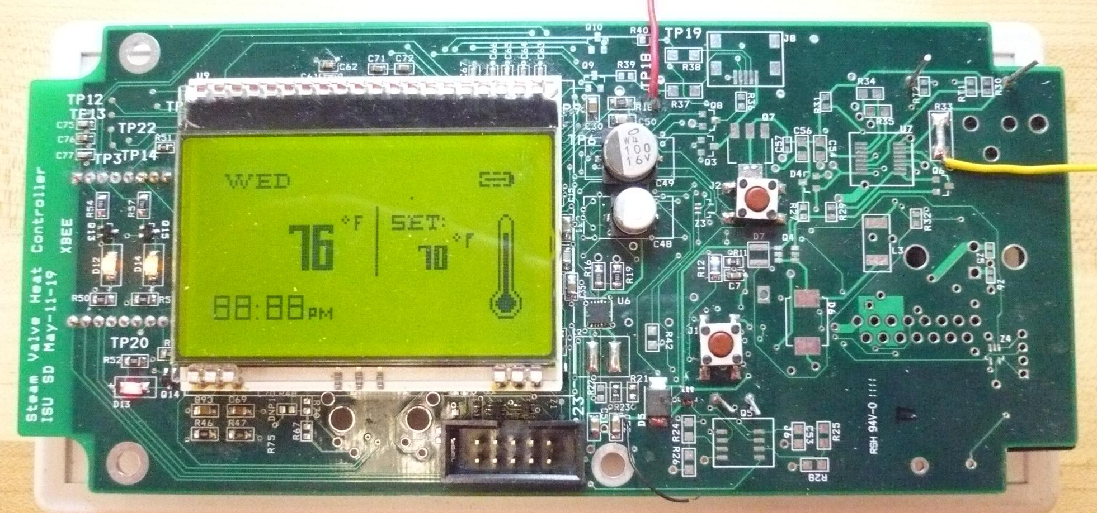
Project Implementation
Control Panel
Microcontroller
Wireless Transceiver
LCD Display
Power Supply
Buzzer
Push Button
Temp Sensor
Recharging Circuitry
Notes:
Buzzer
Push Buttons
Temperature Sensor
Recharging Circuitry

Slide 10
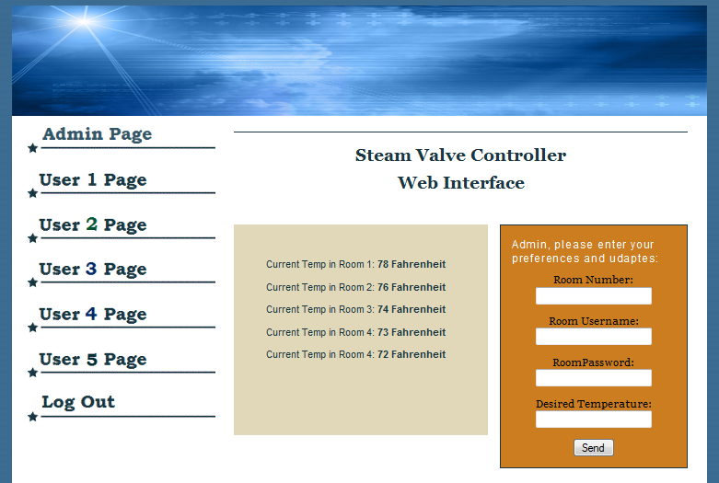
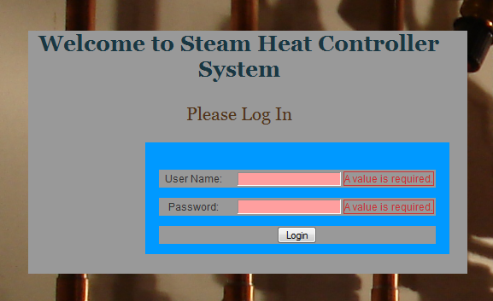
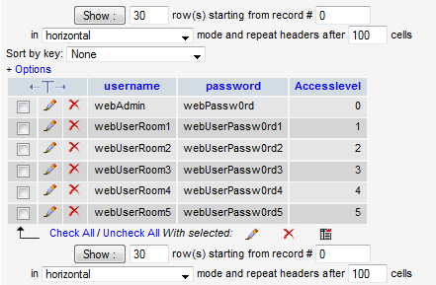
Website Implementation
Website Interface
Login Authentication
Access Levels
Displays Current Temp
Remotely Set Temp

Slide 11
Integration Testing
AVR STK600 Development Kit
Microcontroller
Push Button
Motor System
Temperature Sensor
LCD
Wireless Transceiver

Slide 12
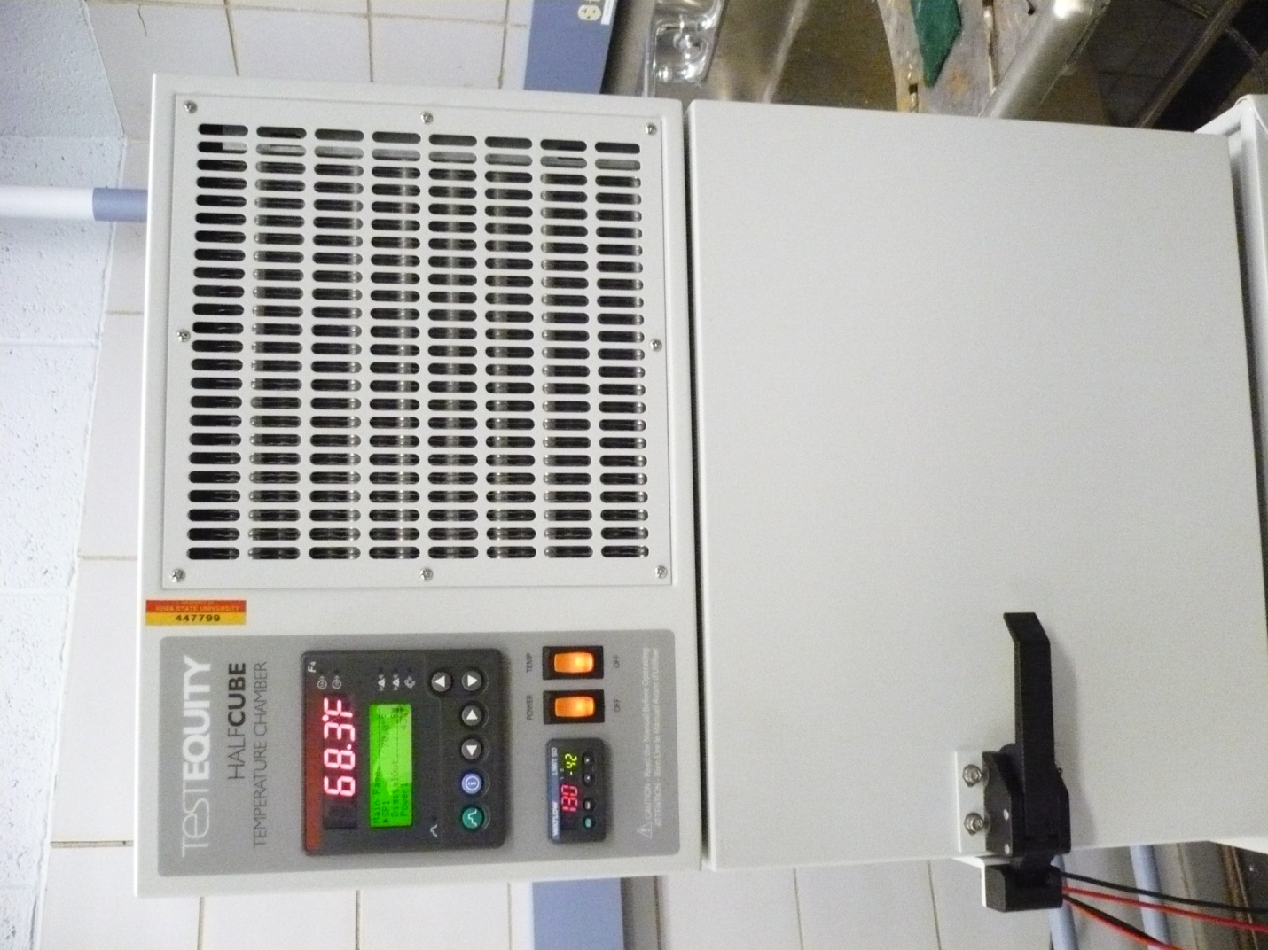
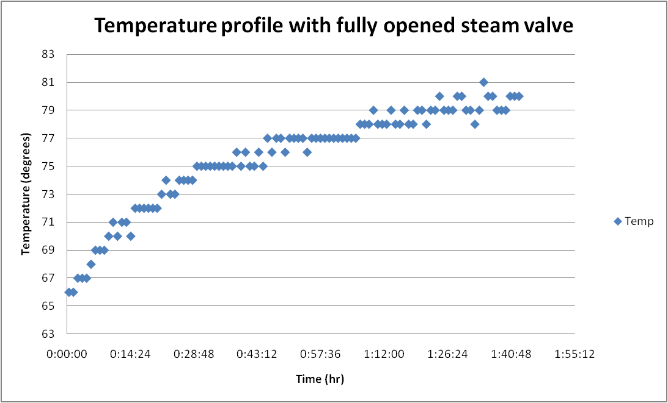
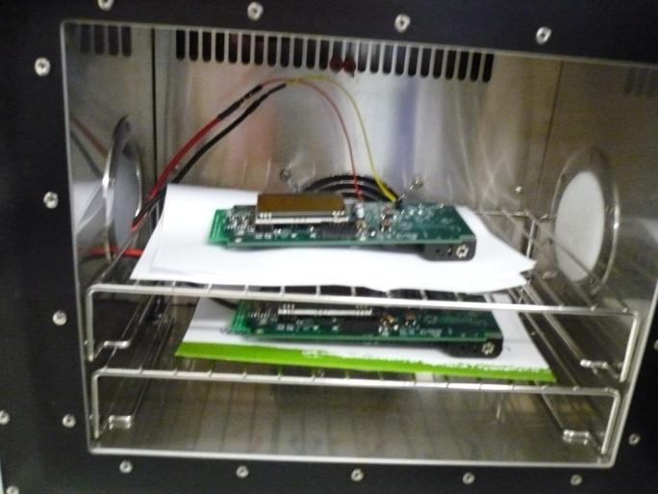
Functional Testing
Simulate operating environment
System performance test

Slide 13
Lessons Learned
PCB Board
Floating pins
Power line routing
Inductor selection
Microcontroller
Integrated Ethernet
Less functionalities
Provide external clock
Motor
Filtering current sense
Encoder with index channel

Slide 14
Conclusion
3 Control panels
1 Controller box
Website
Successful implementation
Possible improvements:
Completion of the recharging circuitry
Ethernet connection
Additional testing
various seasonal and environmental conditions

Slide 15
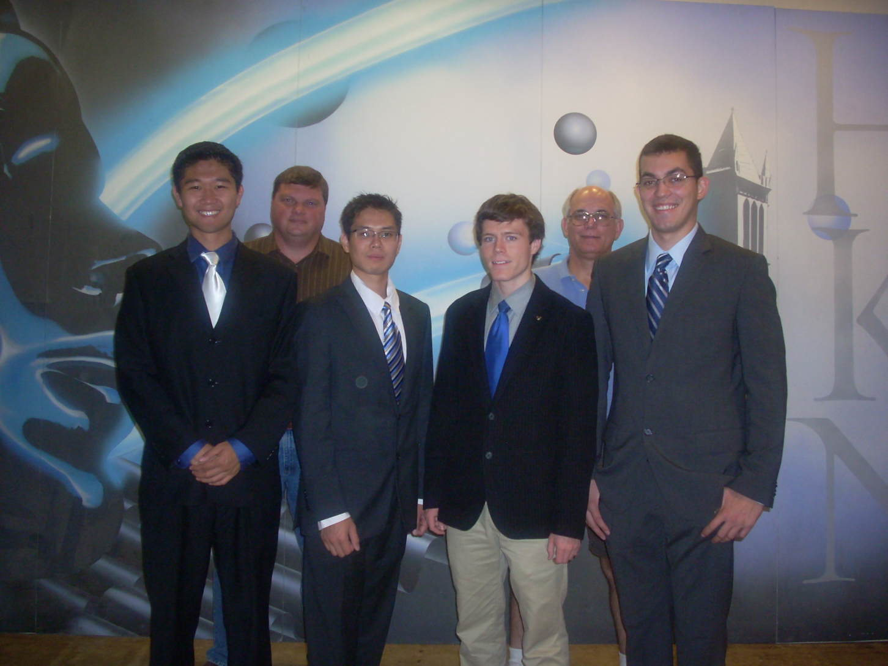
Questions

Slide 16
Thank You

Slide 17
Appendix

Slide 18
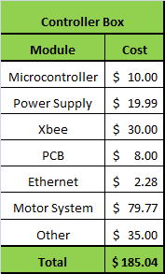
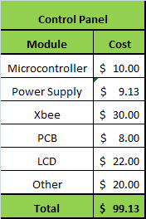
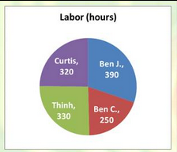
Final Budget

Slide 19
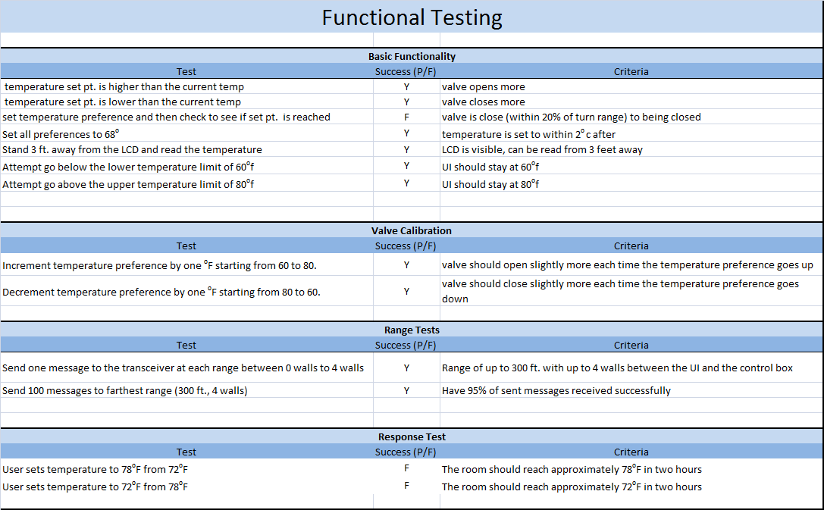
P
P
N/A
P
P
P
P
N/A
N/A
P
P
N/A
N/A

Slide 20
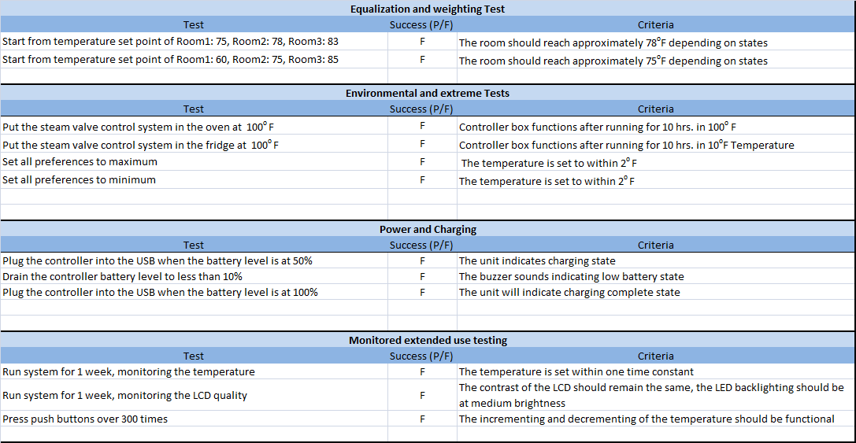

Slide 21
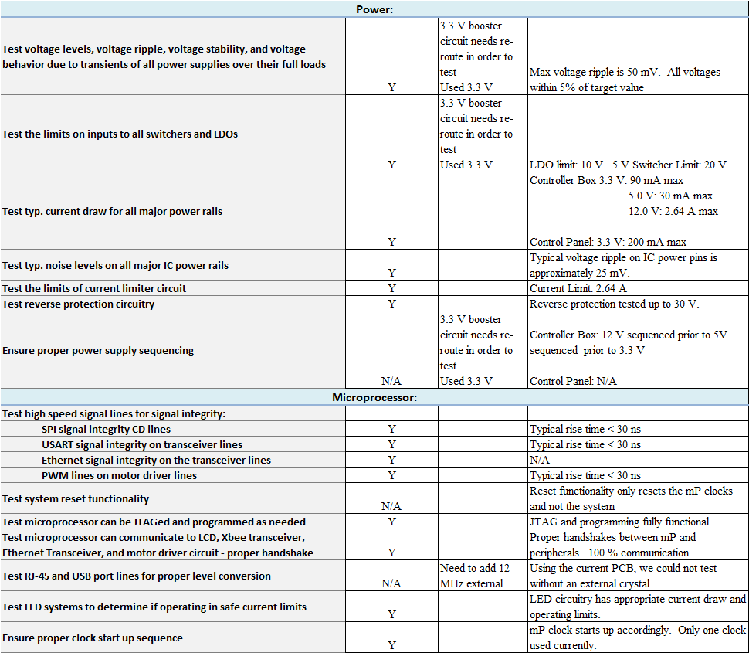

Slide 22
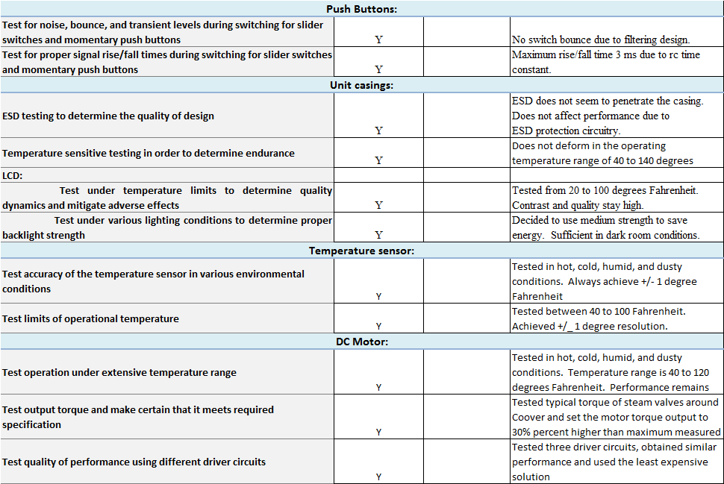

Slide 23
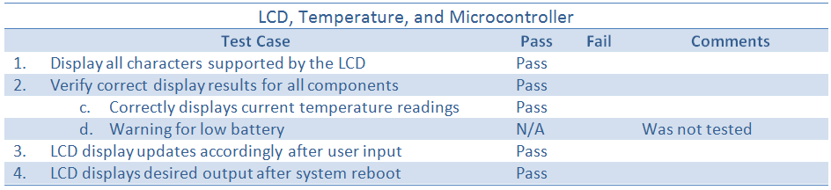
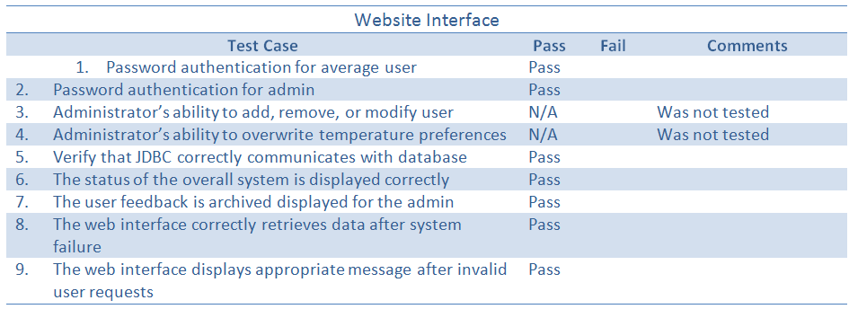
Software Testing Results

Slide 24
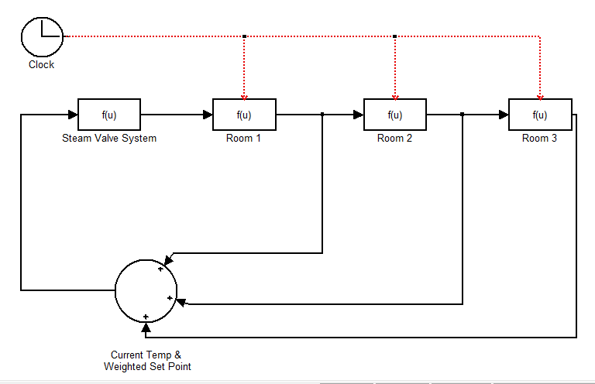
Simulink set up

